Slide 1
Introduction to Azure DevOps
By
Kiran Kumar Vadlamudi

Slide 2
Contents
Azure DevOps Overview
Azure Boards
Azure Repos
Azure Pipelines
Azure Artifacts

Slide 3

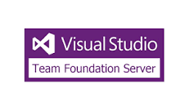

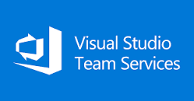
Azure DevOps Overview
Team Foundation Server
First release of TFS. Focussing on the management of work and centralized source control.
Visual Studio Online
VSO is released as the SaaS Counterpart of the existing on premises ALM offering.
Visual Studio Team Services
A rebrand of VSO to gear it more towards DevOps. This version was the first to include first five users.
Azure DevOps
To further increase the focus on DevOps the product was again renamed.
2005
2013
2015
2018

Slide 4
Azure Boards
What are azure boards and how you use them to manage your work

Slide 5
Azure Repos
used to store code and manage pull requests

Slide 6
Azure pipelines
Builds and Releases
Agents and Agent Pools
Creating a build for web-API
Creating a Release for web-API
Library
Task Groups
Deployment Groups

Slide 7
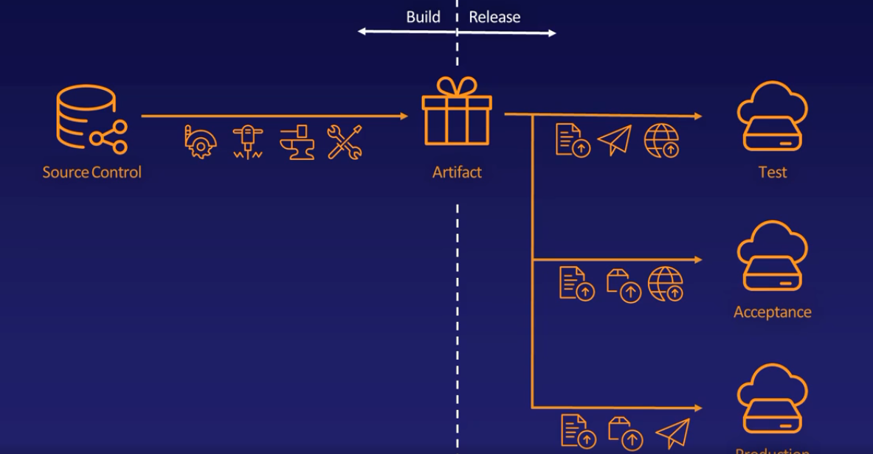
Builds Vs. Releases

Slide 8
Agents and Agent Pools
Pipeline
Team Project
Phase
Agent Pool
Task
Agent
Demand
Capability

Slide 9
Creating a build for web-API
LAB

Slide 10
Creating a Release for web-API
LAB

Slide 11
Library
A place where you create groups of variables to use in more than one pipeline.
Also a place to store files securely for using in pipelines.

Slide 12
Task Groups
Reuse of Tasks by grouping as one
Created from existing build of tasks

Slide 13
Deployment Groups
Pipeline
Deployment Pool
Deployment Group Job
Deployment Group
Task
Agent
Demand
Capability

